Slide 1
Neural Networks

Slide 2
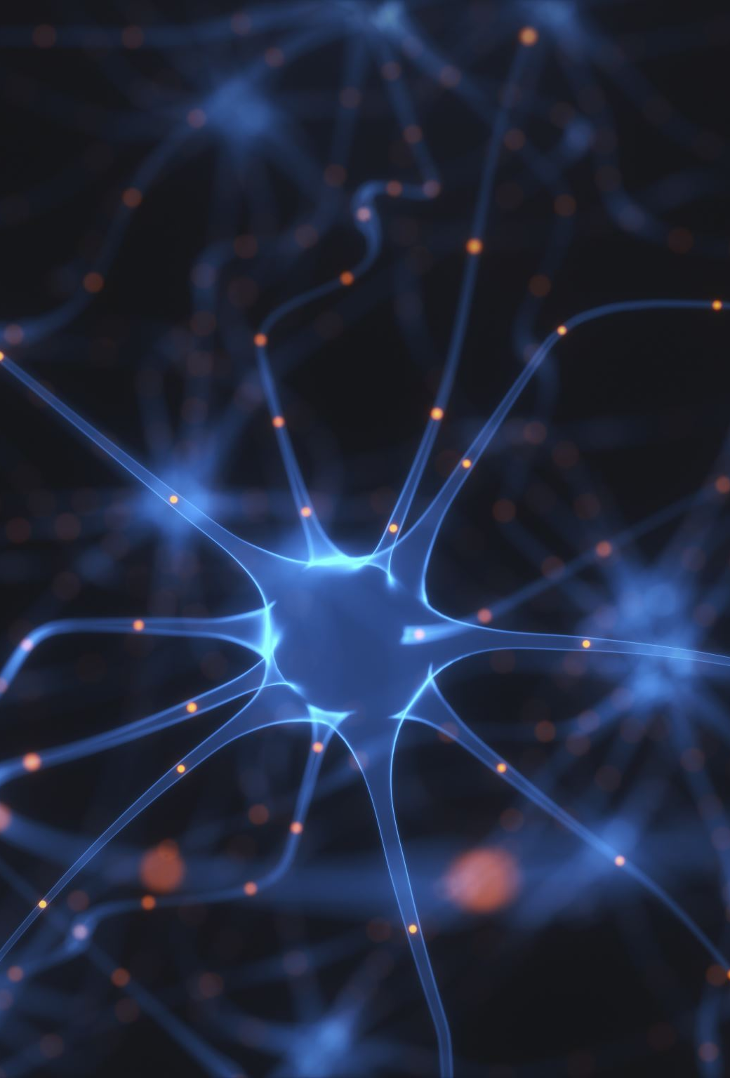
What do we need to know?
A neural network is a machine learning model inspired by the human brain. It consists of layers of artificial neurons that process information and learn patterns from data.
Key Components:
Neurons (Nodes): Basic processing units that apply mathematical functions.
Layers:
Input Layer: Receives raw data (e.g., images, text, or numerical data).
Hidden Layers: Perform computations using weights and activation functions.
Output Layer: Produces final predictions or classifications.

Slide 3
Mathematical Foundation
Weights and Activations function – each neuron calculates a weighting and activation function to the input
Forward propagation – data flows through the network and is transformed layer by layer
Loss function – measure of how well output matches “Truth”
Backpropagation and Gradient Descent – computes gradients of weights and adjusts weights to minimize loss

Slide 4
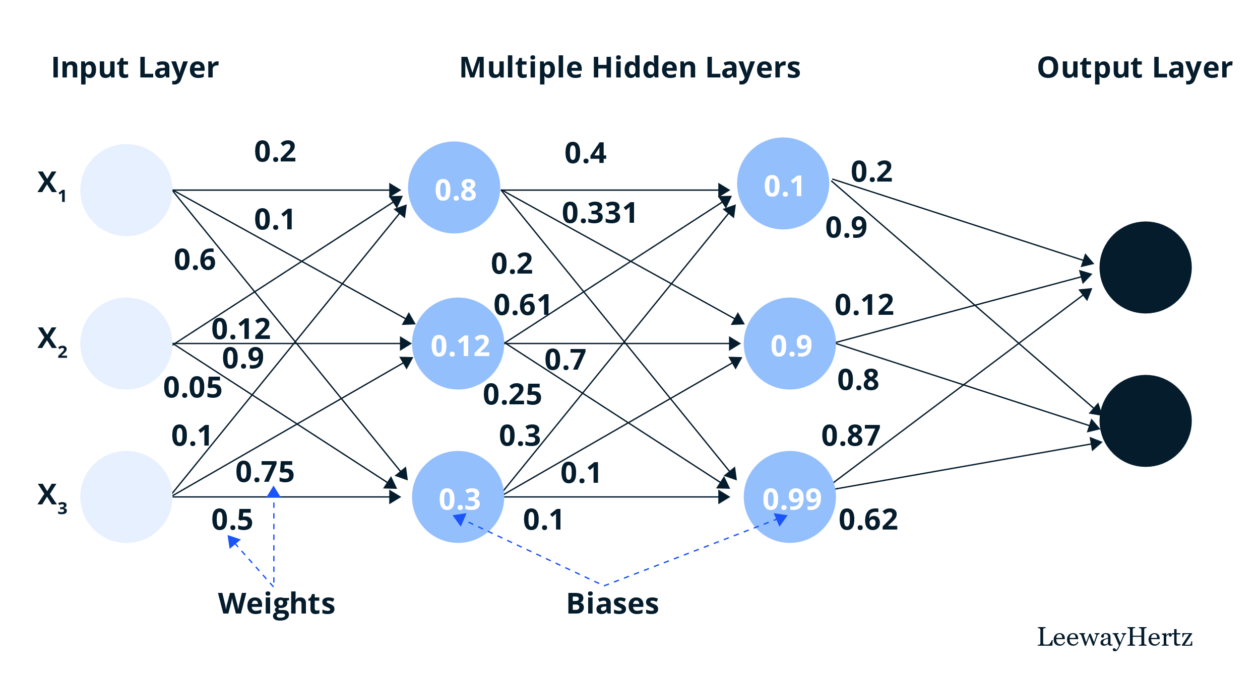
Neural Network Architecture
The number of layers is called the depth of the network
The number of neurons in each layer is called the width of the network

Slide 5
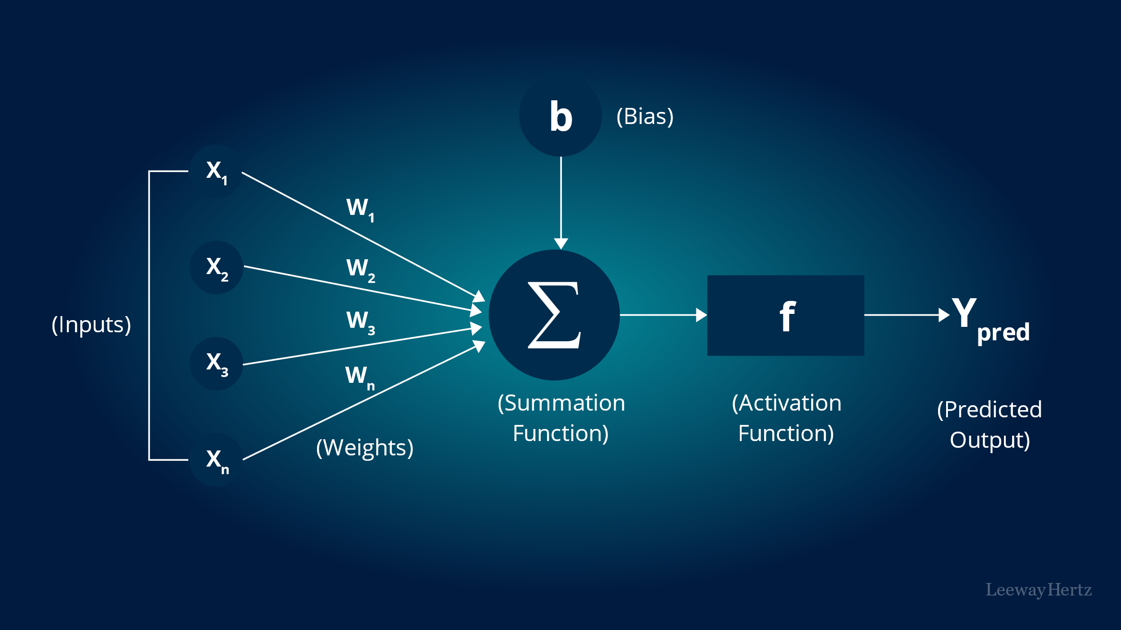
“Connected Deep Neural Network”
Appears complicated but is a simplified architecture.

